Slide 1

HEALTH CARE – DRUG PERSISTENCY
20TH AUGUST 2022

Slide 2
Background
One of the challenge for all Pharmaceutical companies is to understand the persistency of drug as per the physician prescription.
To solve this problem, ABC pharma company is seeking to automate this process of identification.

Slide 3
Problem Statement
To understand the persistency of a drug as per the prescription given by the physician is an important question faced by pharmaceutical companies.
The problem here is to build a classification model to understand the persistency (persistent or not) of a drug for the given dataset.

Slide 4
Models
Linear
Logistic Regression – Linear
Support Vector Classifier
Naïve Bayes
K-Nearest Neighbors
Decision Tree
Ensemble Bagging
Random Forest
Boosting
Adaboost
XGBoost

Slide 5
Tools Used for Comparison
Accuracy Score
Confusion Matrix
Classification Report
Specificity, Sensitivity
Receiver Operating Characteristics (ROC) Curve
Precision Recall Curve
AUC Value
F1 Score

Slide 6
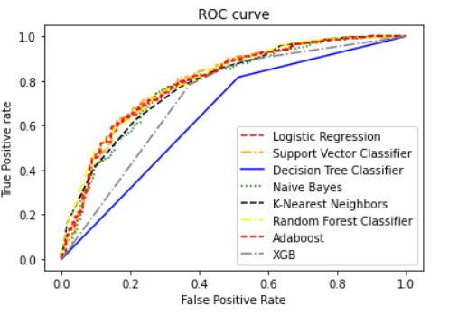
ROC CURVE
Random Forest Classifier and Adaboost has similar Curve.

Slide 7
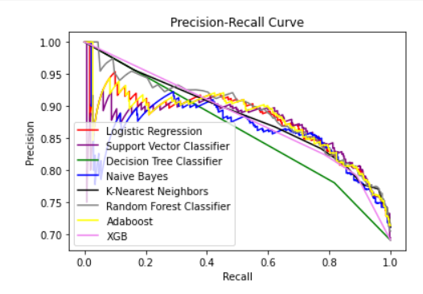
Precision-Recall CURVE

Slide 8
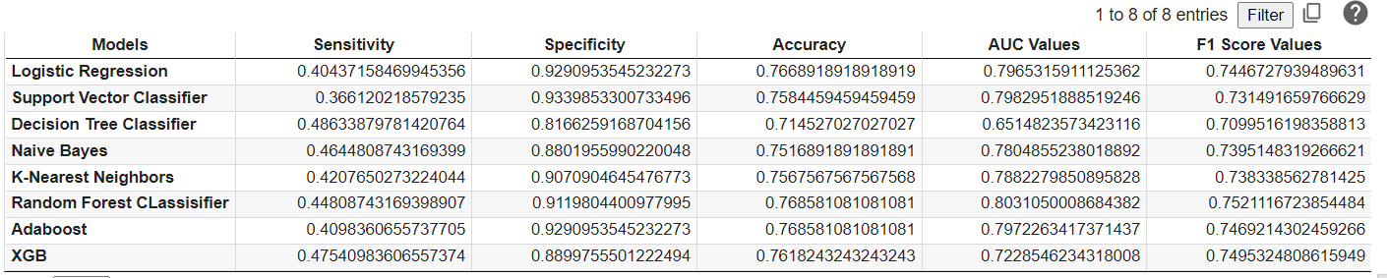
Comparison Matrix
The best model from the above values is Random Forest Classifier.

Slide 9
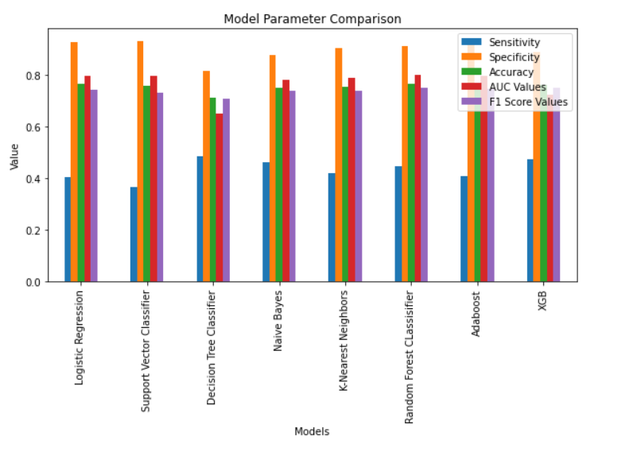
Comparison Matrix
The best model from the above values is Random Forest Classifier.

Slide 10
Proposed Model
The proposed model is Random Forest Classifier.
Testing Accuracy: 0.769
Sensitivity: 0.448
Specificity:0.912
AUC Value:0.803
F1 Score:0.752

Slide 11
Prediction System
Inputs a series of 6 values (Assumption: Input happens after PCA)
Apply Standard Scaler
Input to RFC model to predict the output
Convert the numerical output to Categorical

Slide 12
Summary
From various Classification models, Random Forest Classifier was chosen based on the various parameter values.
It has the highest accuracy of 76.9
This could be the efficient model for the automation of the prediction of persistent or non-persistent drugs.

Slide 13

Thank You

